Slide 1
Unit 1
FINITE AUTOMATA

Slide 2
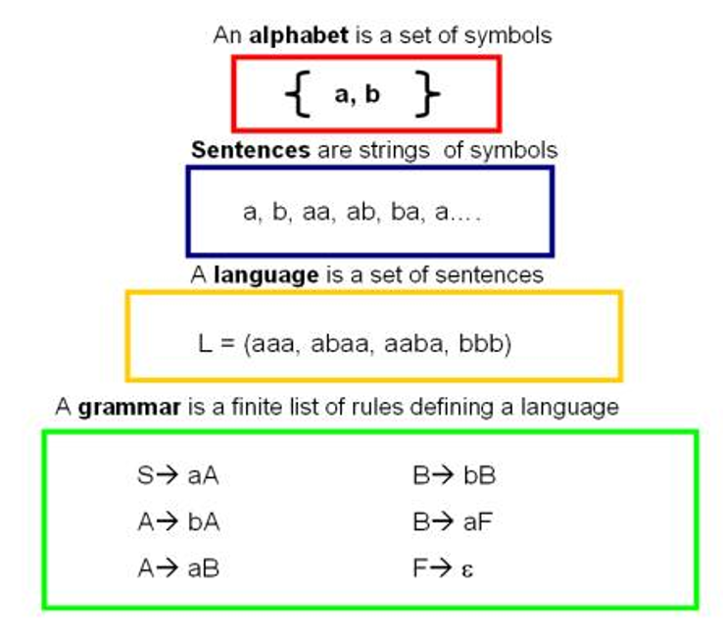
Finite Automata
Definition: Finite automata are abstract machines used to recognize patterns in input sequences, forming the basis for understanding regular languages in computer science.

Slide 3
Why is Automata Theory Important?
Foundation of Computation: It helps in understanding how machines process information.
Compiler Design: Finite automata and pushdown automata are used in lexical analysis and parsing.
Artificial Intelligence: Automata models are used in natural language processing (NLP).
Software Verification: Helps in checking if a program behaves correctly.
Algorithm Design: Provides insights into problem-solving techniques.

Slide 4
Formal Definition of Finite Automata
A finite automaton can be defined as a tuple:
{ Q, Σ, q, F, δ }, where:
Q: Finite set of states
Σ: Set of input symbols
q: Initial state
F: Set of final states
δ: Transition function

Slide 5
Finite Automaton
Input
String
Output
“Accept”
or
“Reject”
Finite
Automaton

Slide 6
Transition Graph or Transition Diagram or State Diagram
initial
state
accepting
state
transition
state

Slide 7
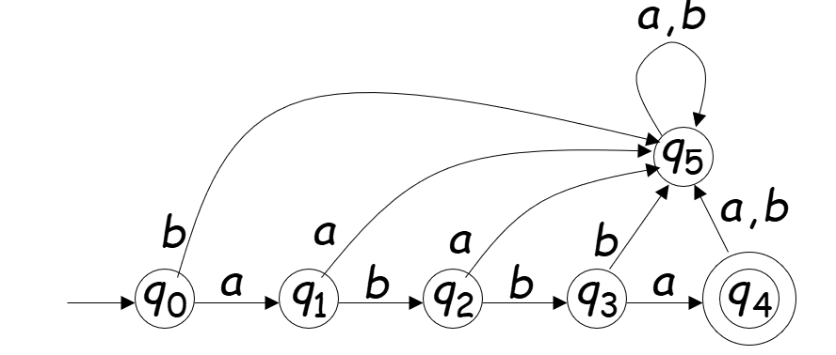
Transition Table
States | INPUTS
 | a | b
-> q₀ | q₁ | q₅
q₁ | q₅ | q₂
q₂ | q₅ | q₃
q₃ | q₅ | q₄
q₄ | q₅ | q₅
q₅ | q₅ | q₅
q₄

Slide 8
Initial Configuration
Input String

Slide 9
Reading the Input

Slide 13
Input finished
accept

Slide 14
Rejection

Slide 18
Input finished
reject

Slide 19
Another Rejection

Slide 20
reject

Slide 21
Another Example

Slide 25
Input finished
accept

Slide 26
Rejection Example

Slide 30
Input finished
reject

Slide 31
accept

Slide 32
Example
accept
accept
accept

Slide 33
Example
accept
trap state

Slide 34
Transition Function

Slide 38
Transition Function

Slide 39
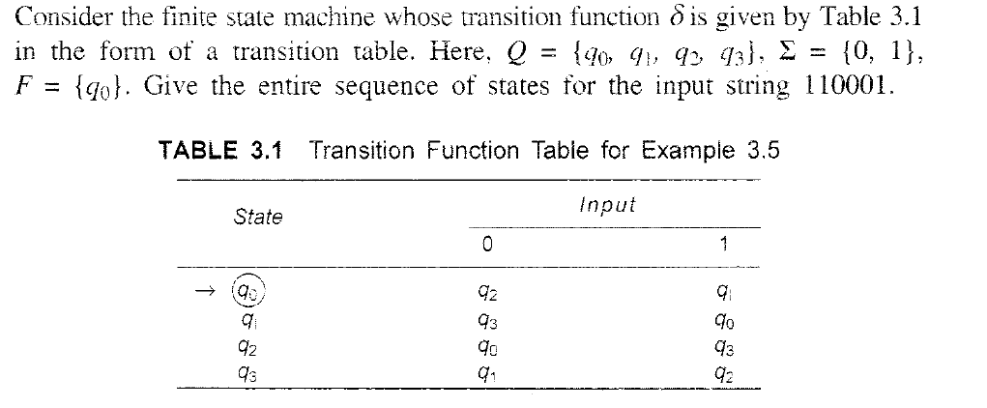

110101

Slide 40
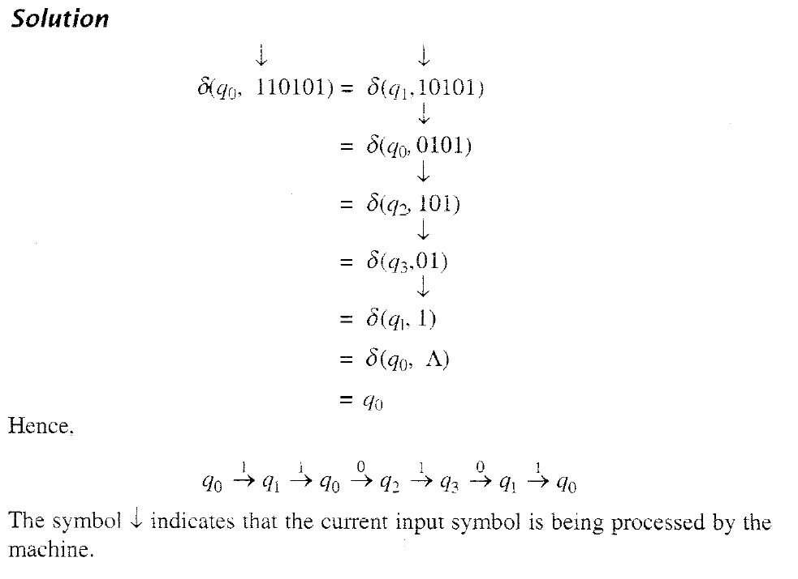

Slide 41
Two types of Finite Automata
DFA (Deterministic Finite Automata)
NDFA (Non- Deterministic Finite Automata)

Slide 42
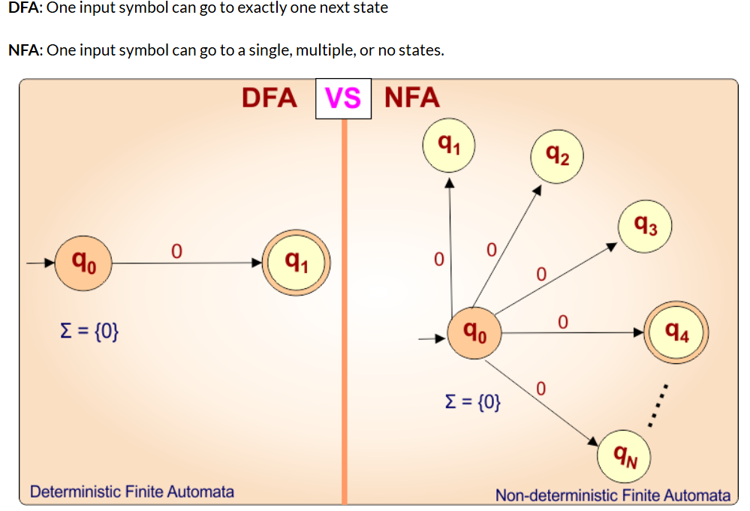
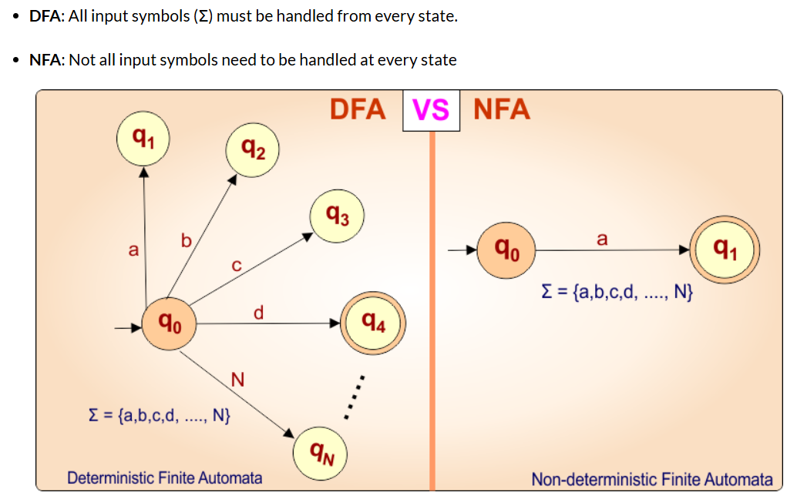
Difference between DFA and NDFA

Slide 43
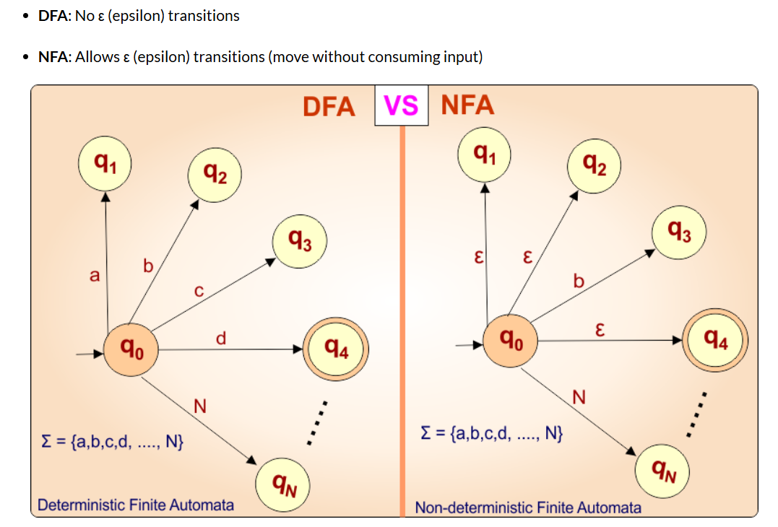
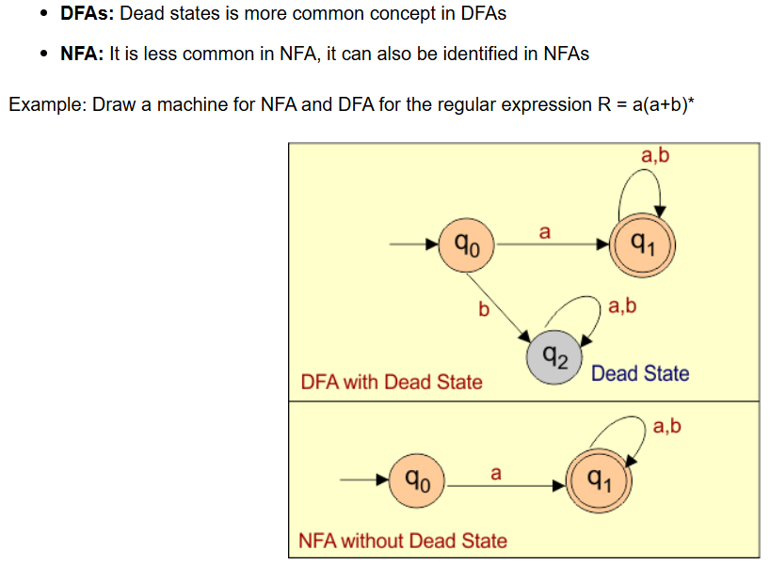
A dead state is more common in a DFA because a DFA must define one transition for every input from every state, even if the input is not accepted. In NFA, missing transitions are allowed, so dead states are often unnecessary.

